Slide 1
Generative Type
Danne Woo
Email: danne@dannewoo.com
Twitter: @dannewoo

Slide 2
Datavisual
Danne Woo Design
Queens College

Slide 3
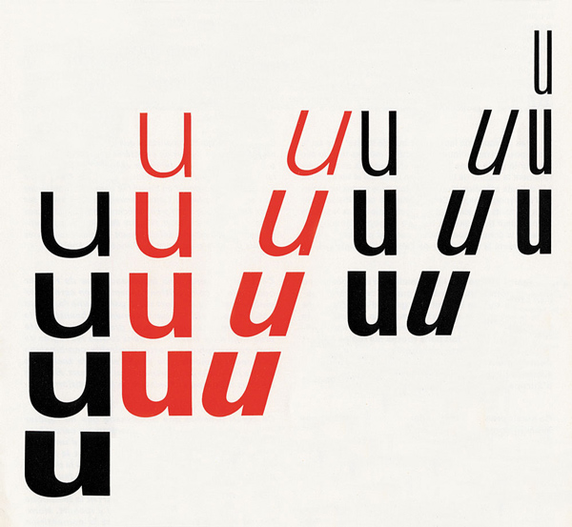
Rule-Base Type
Notes:
One of the first fonts to focus on a variable set of related shapes was the Univers typeface by Adrian Frutiger. Made in 1954, Frutigers approach to the design of Univers was drastically different than that of others fonts: Instead of focusing on the relation between the letters of the same weight, he focused on creating a system of inter-related weights that would function well against each other.

Slide 4
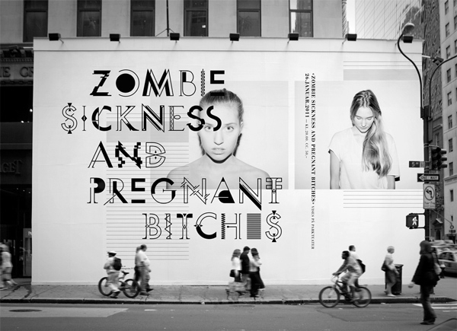
Rule-Base Type
Lava Sans Avec
Notes:
This is a dynamic typeface made for the small film studio “Lava Films”. The company is based on the concept of natural disasters: Things moving to non-anticipated places. The type designers used that theme when designing Lava Sans for them.

Slide 5
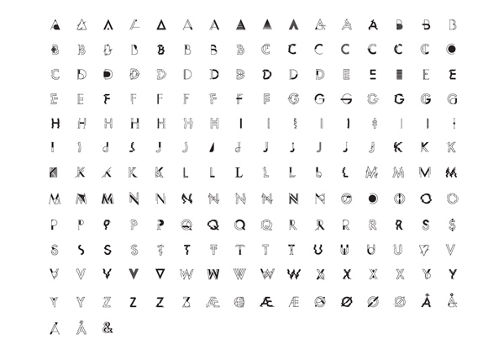
Notes:
This is also very much a type system. There are about 15 options for each letter and you never know which you will get. Although this is all done by hand, not programmatically.

Slide 6
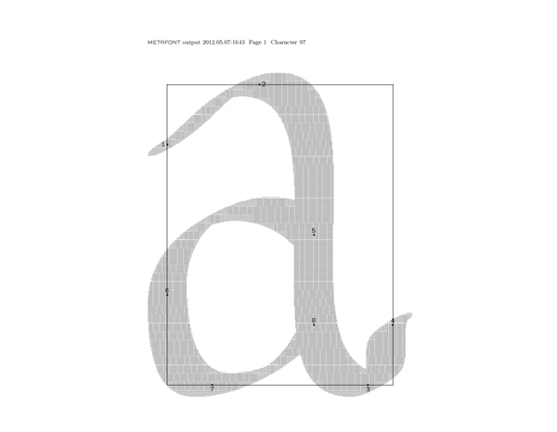
Rule-Base Type
MetaFont
Notes:
Created in 1977 by Donald Knuth for the typesetting of his series of books, The Art of Computer Programming, MetaFont was possibly the world’s first rule-based typeface. Most fonts are created by designing the outline of the font. When a typeface has to be created in different weights, you cannot just “grow” or “shrink” this outline computationally. A designer has to sit and create new outlines by hand. MetaFont takes a drastically new approach. Instead of being described by its outline, this font is represented by a series of variables inspired by handwriting: Pen, Weight, Slant, Superness and Curlyness

Slide 7
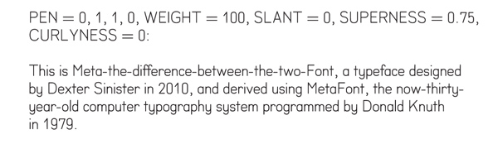
Rule-Base Type
MetaFont
Notes:
By manipulating these variables you can create very different styles of the MetaFont. These parameters create a neo-grotesque typeface.

Slide 8
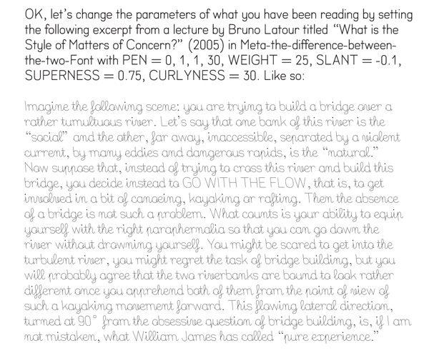
Rule-Base Type
MetaFont
Notes:
These parameters create a script typeface.

Slide 9
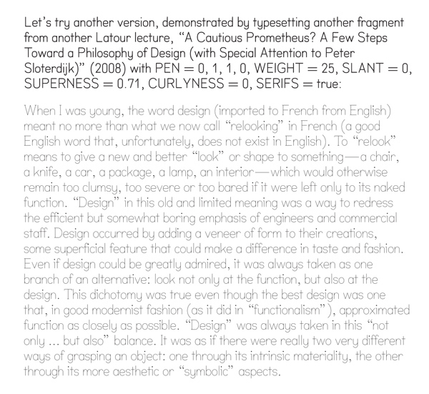
Rule-Base Type
MetaFont
Notes:
These parameters create a simple slab serif typeface.

Slide 10
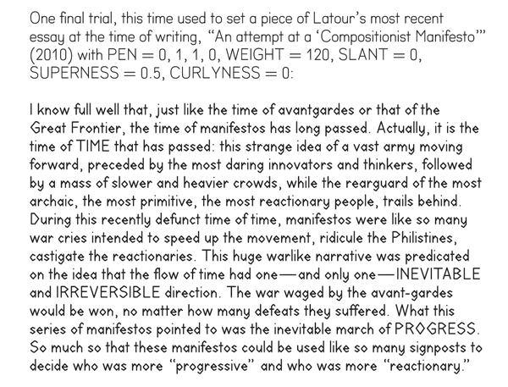
Rule-Base Type
MetaFont
Notes:
And these parameters create a geometric looking display typeface.

Slide 11
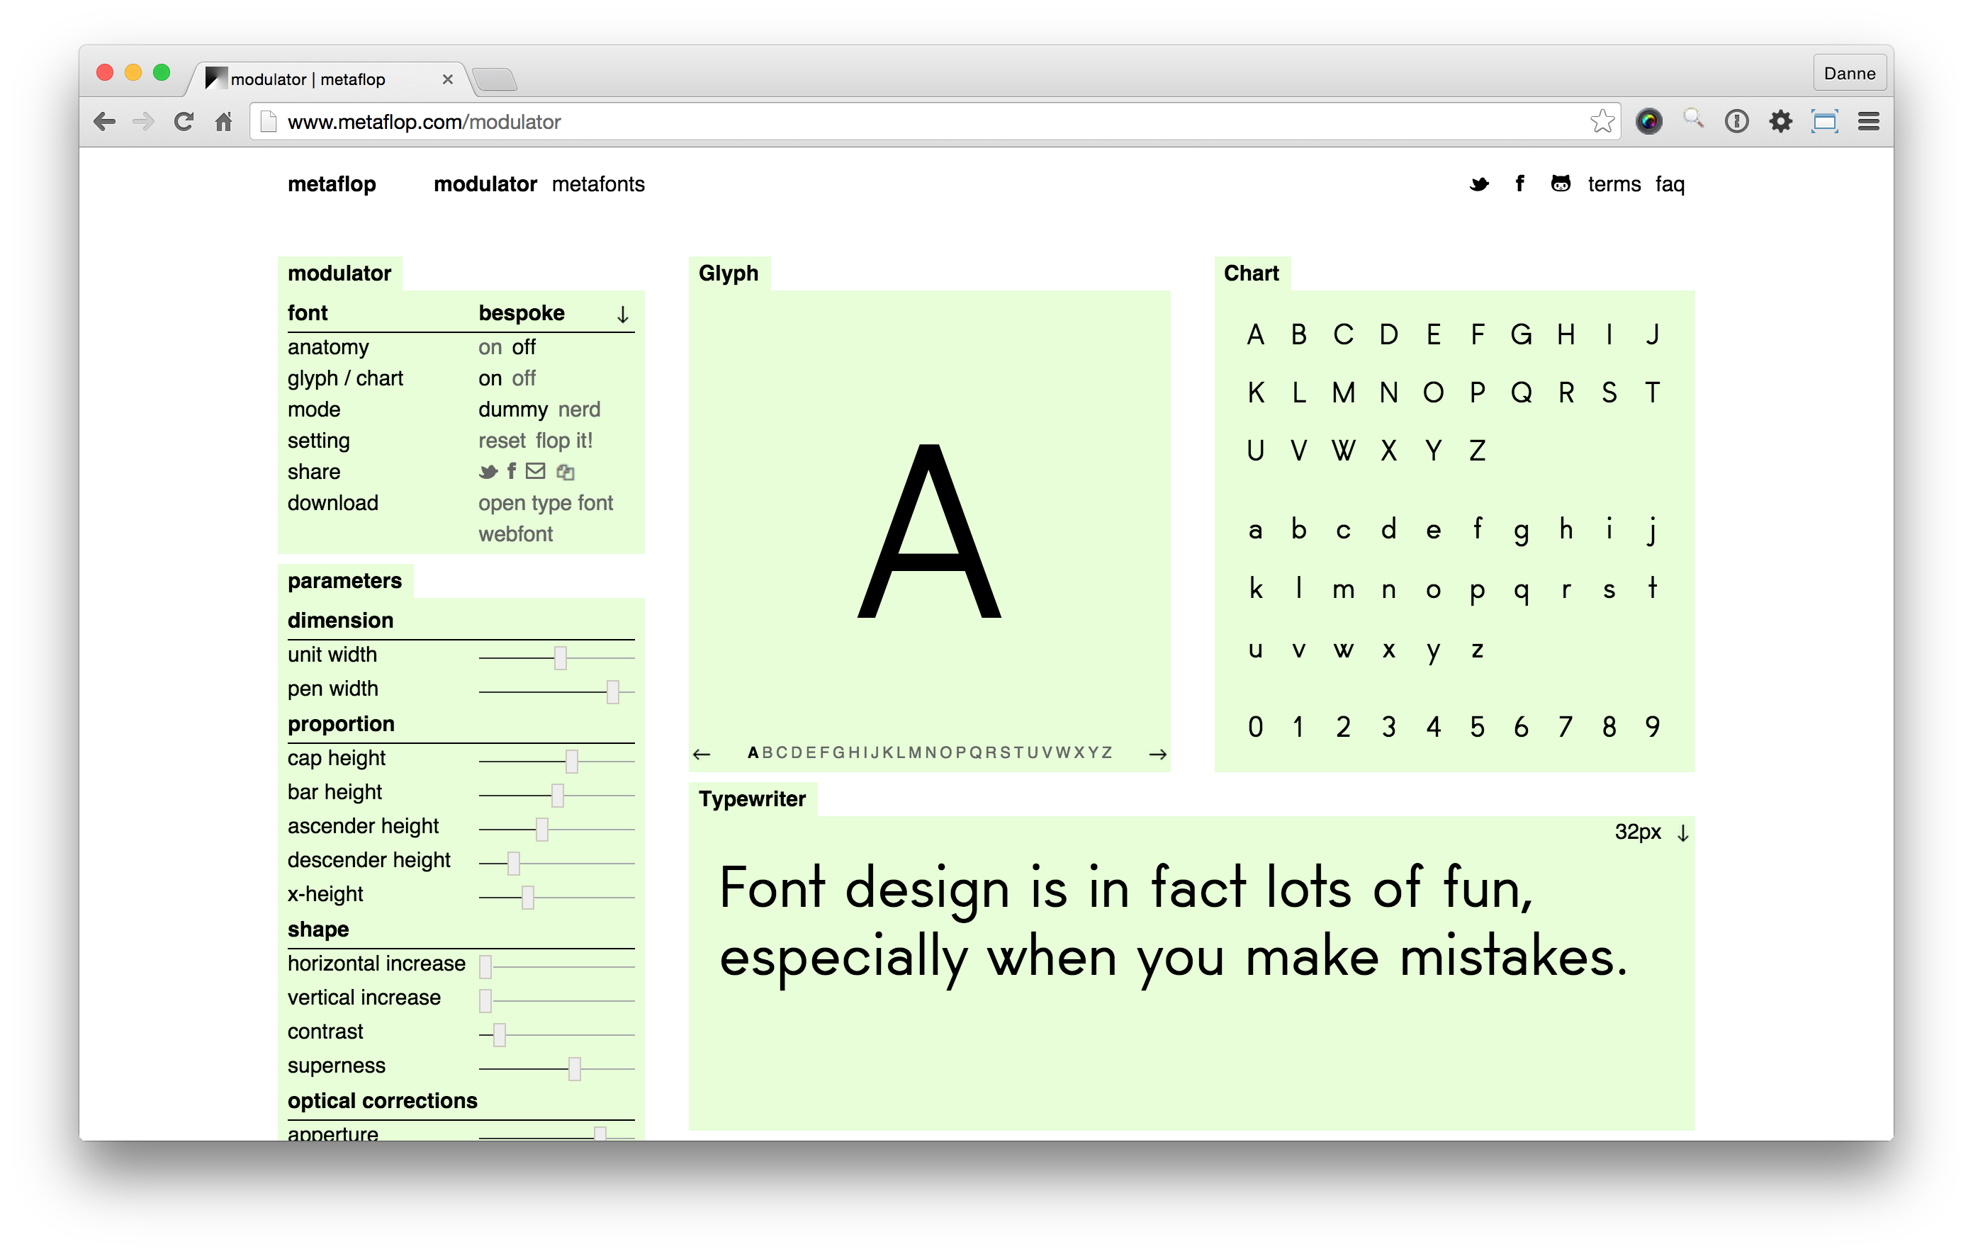
Rule-Base Type
MetaFlop

Slide 12
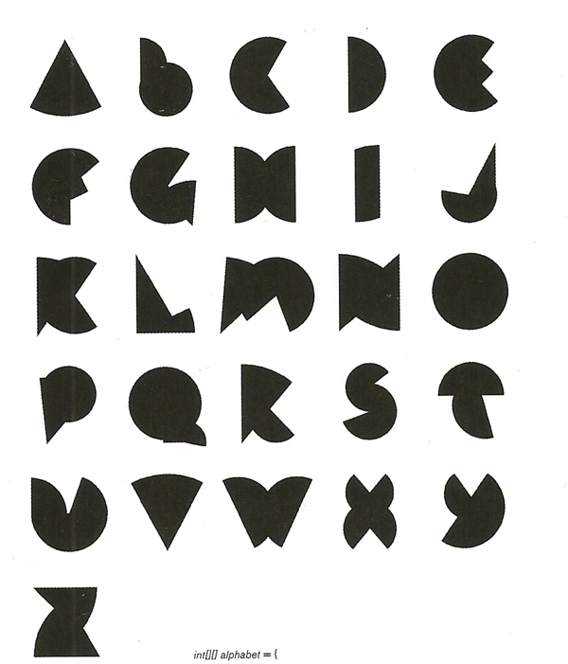
Rule-Base Type
int [] [] alphabet = { }
Notes:
This project by Peter Cho uses degrees of a circle to create this very simple geometric typeface. Each letter is generated with only 2 arcs, and the entire typeface is derived from twenty-six groups of only ten numbers.

Slide 13
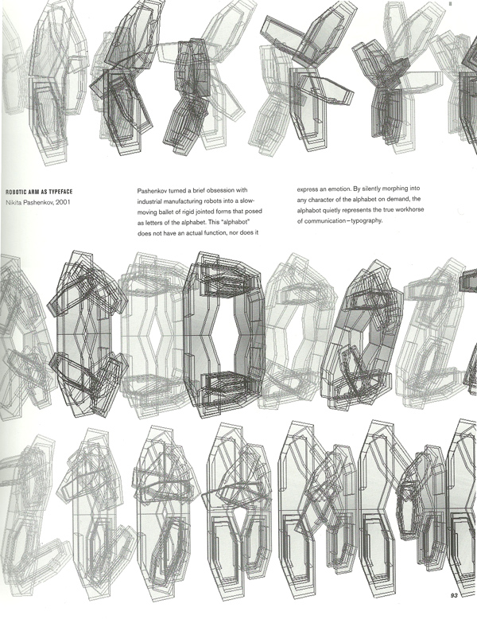
Rule-Base Type
Robotic Arm as Typeface
Notes:
Heres a project from the Aesthetics and Computation Group at MIT. It’s called “Robotic Arm as Typeface”, and that’s exactly what it is. A typeface made up of a single, moving robotic arm.

Slide 14
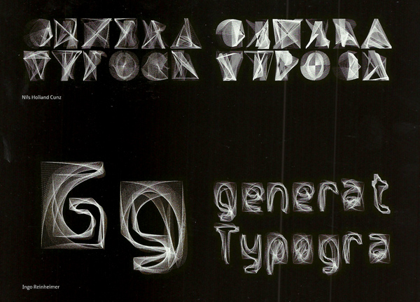
Outline Based
Generative Typografie (http://generative-typografie.de/)
Notes:
Now when it comes to outline based type, we start to get into more abstract type that is not necessarily meant to be very legible. This is a showcase of final projects from a class at a German University on generative typography. They are acutally using the Geomerative library and Processing to find the outlines of a existing typeface and modify it further.

Slide 15
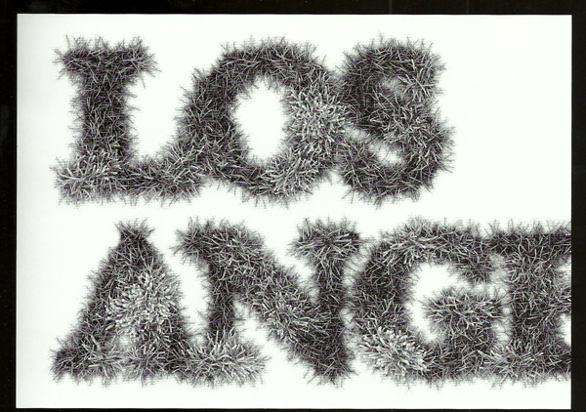
Outline Based
Growing Data
Notes:
Here’s a project combining data and typography. “Growing Data” from 2008.

Slide 16
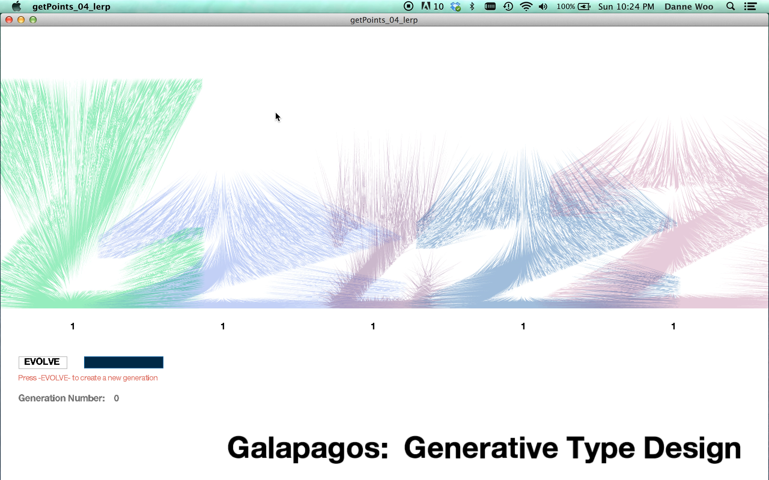

Slide 17


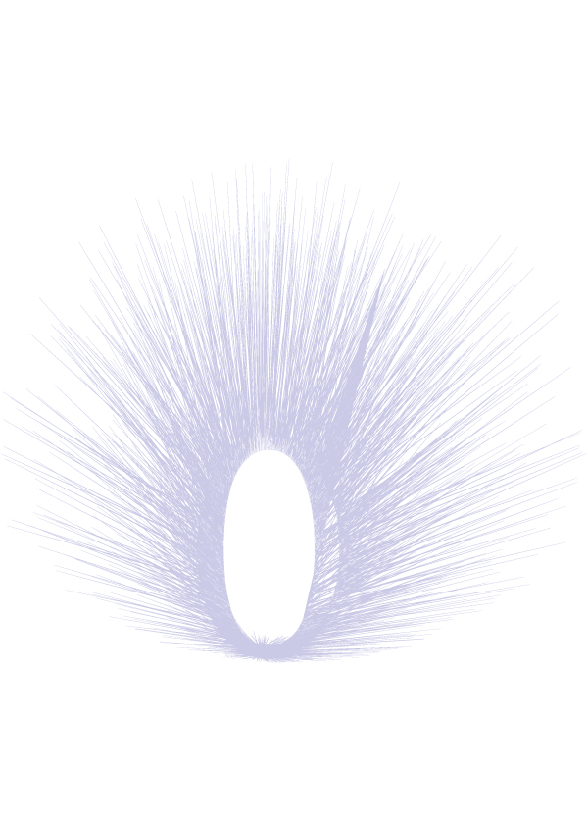
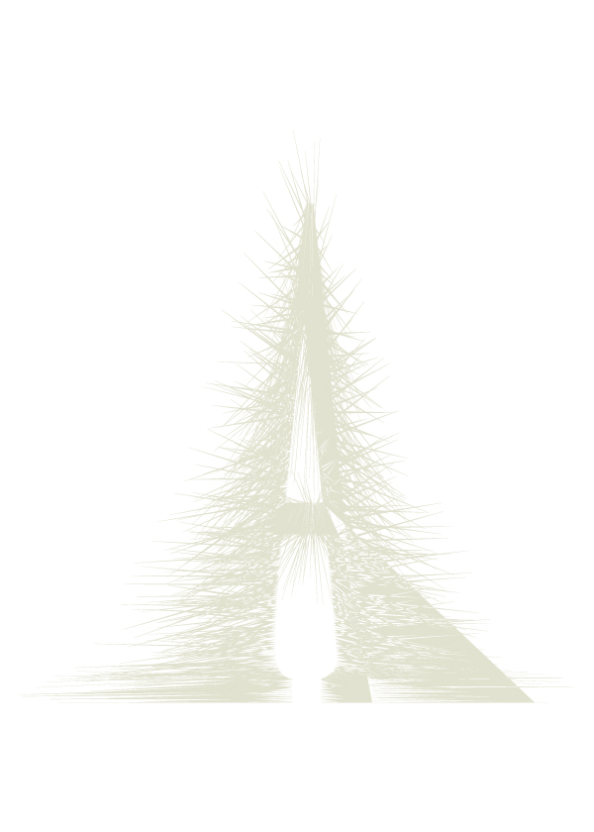
Outline Based
Type Galapagos
Notes:
This is a project I worked on called Type Galapagos that uses an evolutionary algorithm to generate letterforms based on genetics.

Slide 18
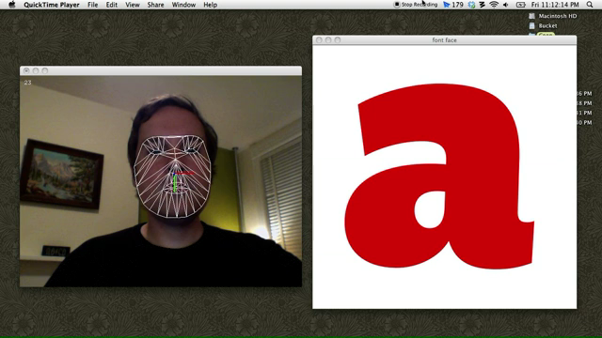
Outline Based
Notes:
Heres Andy Clymers font face that changes the parameters of a letterform based on opening his eyes and mouth as well as tilting his head from side to side.

Slide 19
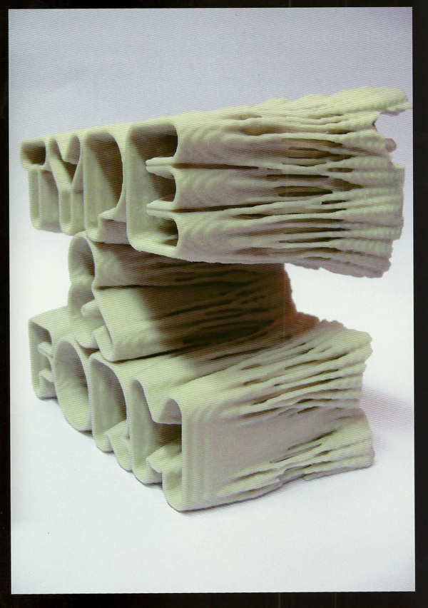
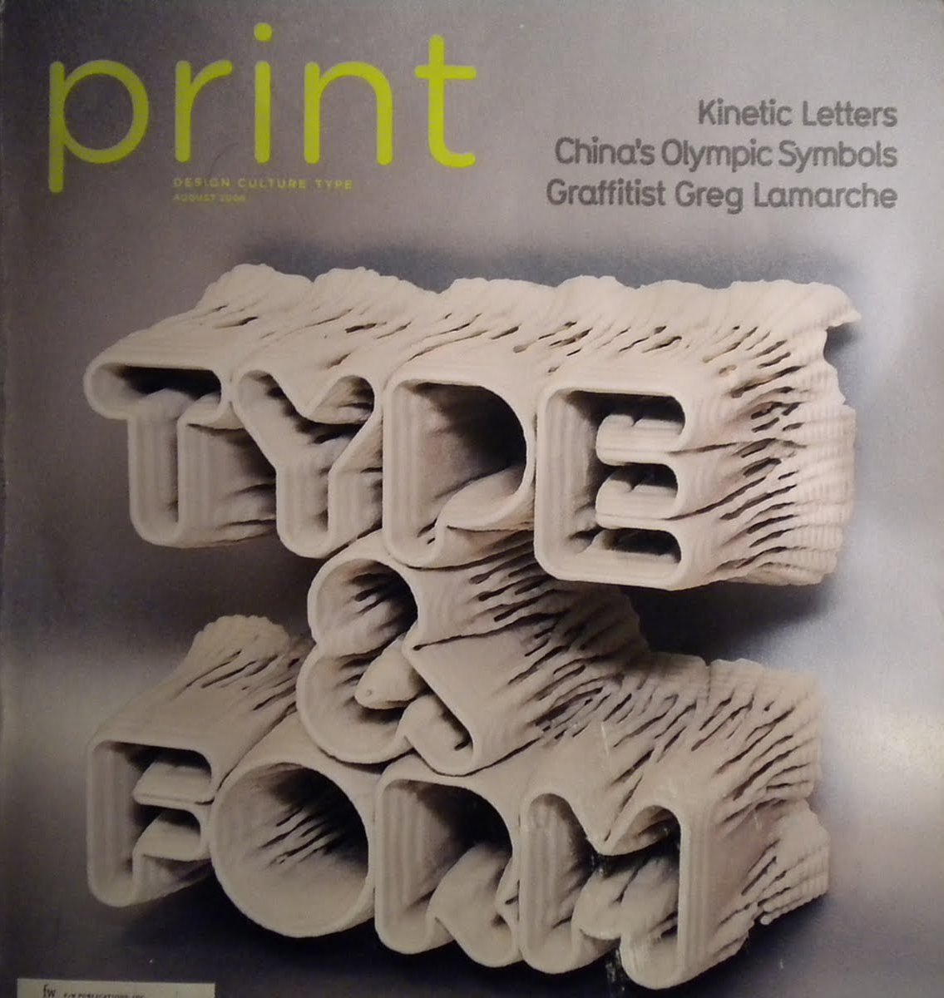
Outline Based
Type and Form, for Print Magazine
Notes:
Of course there’s Karsten Schmidts evolutionary typeface, that he programmed and 3D printed for “Print” magazine.

Slide 20
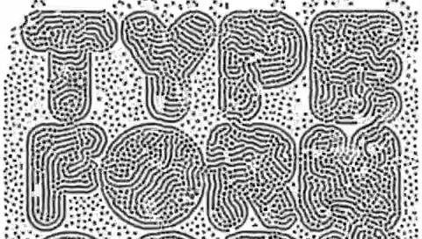
Notes:
Heres one of the first sketches Karsten created.

Slide 21
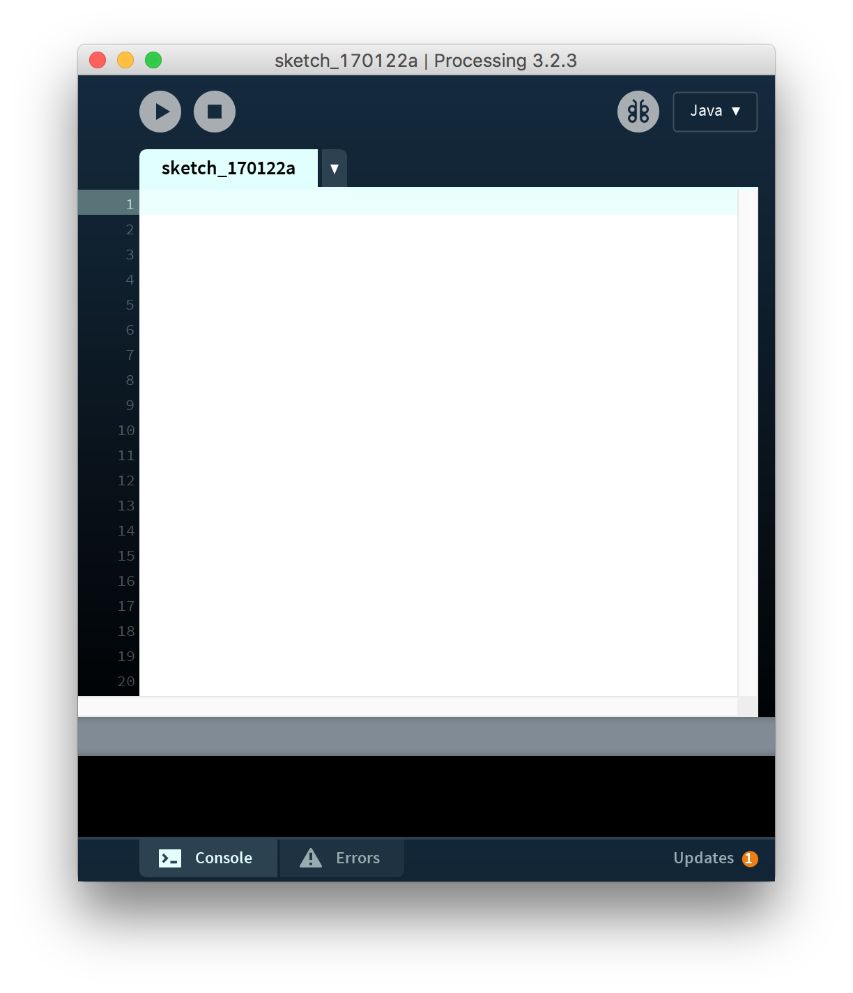

Processing
www.processing.org
Notes:
Processing is the framework we will be using for this class. It uses a object oriented programming language called Java. It is created by two MIT Media Lab alums, Casey Reas and Ben Fry. Casey and Ben created Processing specifically with visual artists and designers in mind, which makes it a great framework for visual learners who are interested in learning more about code.

Slide 22
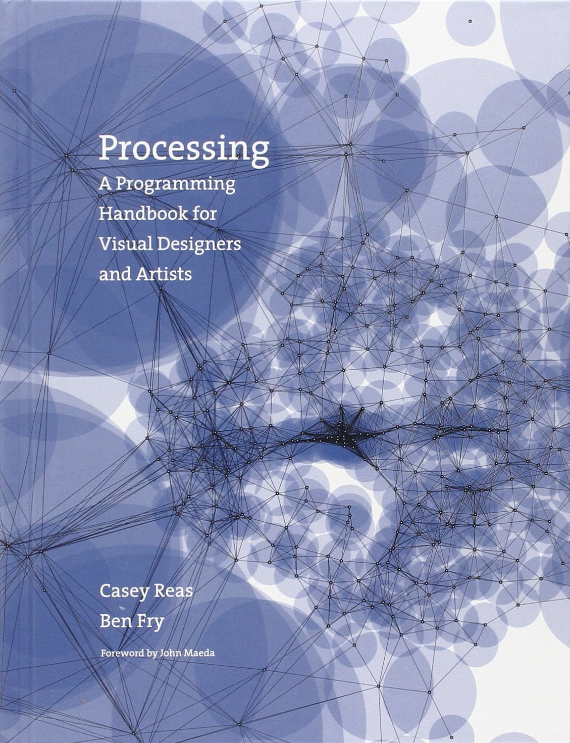
Suggested Reading
Notes:
This is the textbook we will be using for this class. It is also written by Casey and Ben and uses a lot of visual examples to help you see what is actually going on with the code.

Slide 23
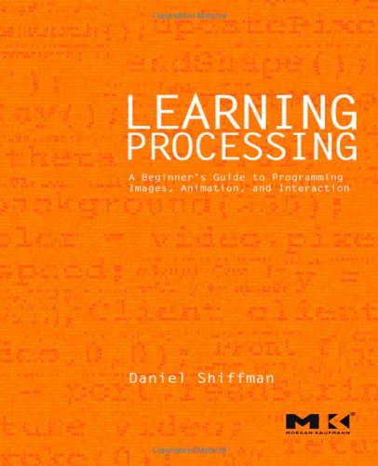
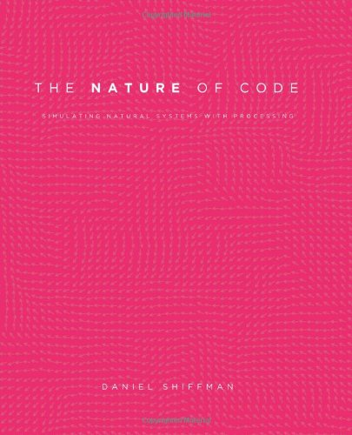
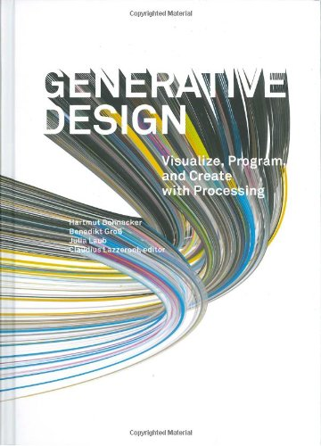
Suggested Reading
Notes:
There are a number of amazing books out there on Processing. These are my three favorites. Learning Processing was written by Dan Shiffman who is a major contributor to the Processing framework as well as the person who taught me how to code. Generative Design is a beautiful book that is similar to Casey and Bens and uses a lot of visuals to help explain what is going on in the code. And if you are interested in replicating Nature with code I highly recommend Shiffmans Nature of Code book, this book is actually free online at natureofcode.com.

Slide 24
“The possibilities of programming languages such as Processing will change the role of the designer. We are experiencing a paradigm shift in design that will lead to new realms of visual imagery. Knowledge of this change, however, has been somewhat inaccessible. Until now, designers have used the tools that programmers have developed for them, which has forced designers to adjust to their systems.”
- Generative Design
Notes:
There is actually a really great quote in the Generative Design book that kind of sums up what I think the future of design is.

Slide 25


Why?
vs
Limited to Tools
Vector Based
Repetition
Patterns
Randomization
Data Driven Design
Custom Functions
Custom Algorithms
Custom GUI
FREE
Notes:
So why use Processing over a tool that you might be more familiar with like Adobe Illustrator. Any software you use has limitations based on what the programmers included. With Processing or something similar you can create custom functions, algorithms, graphic user interfaces and even create your own custom software for your specific needs. On top of that its also free.

Slide 26
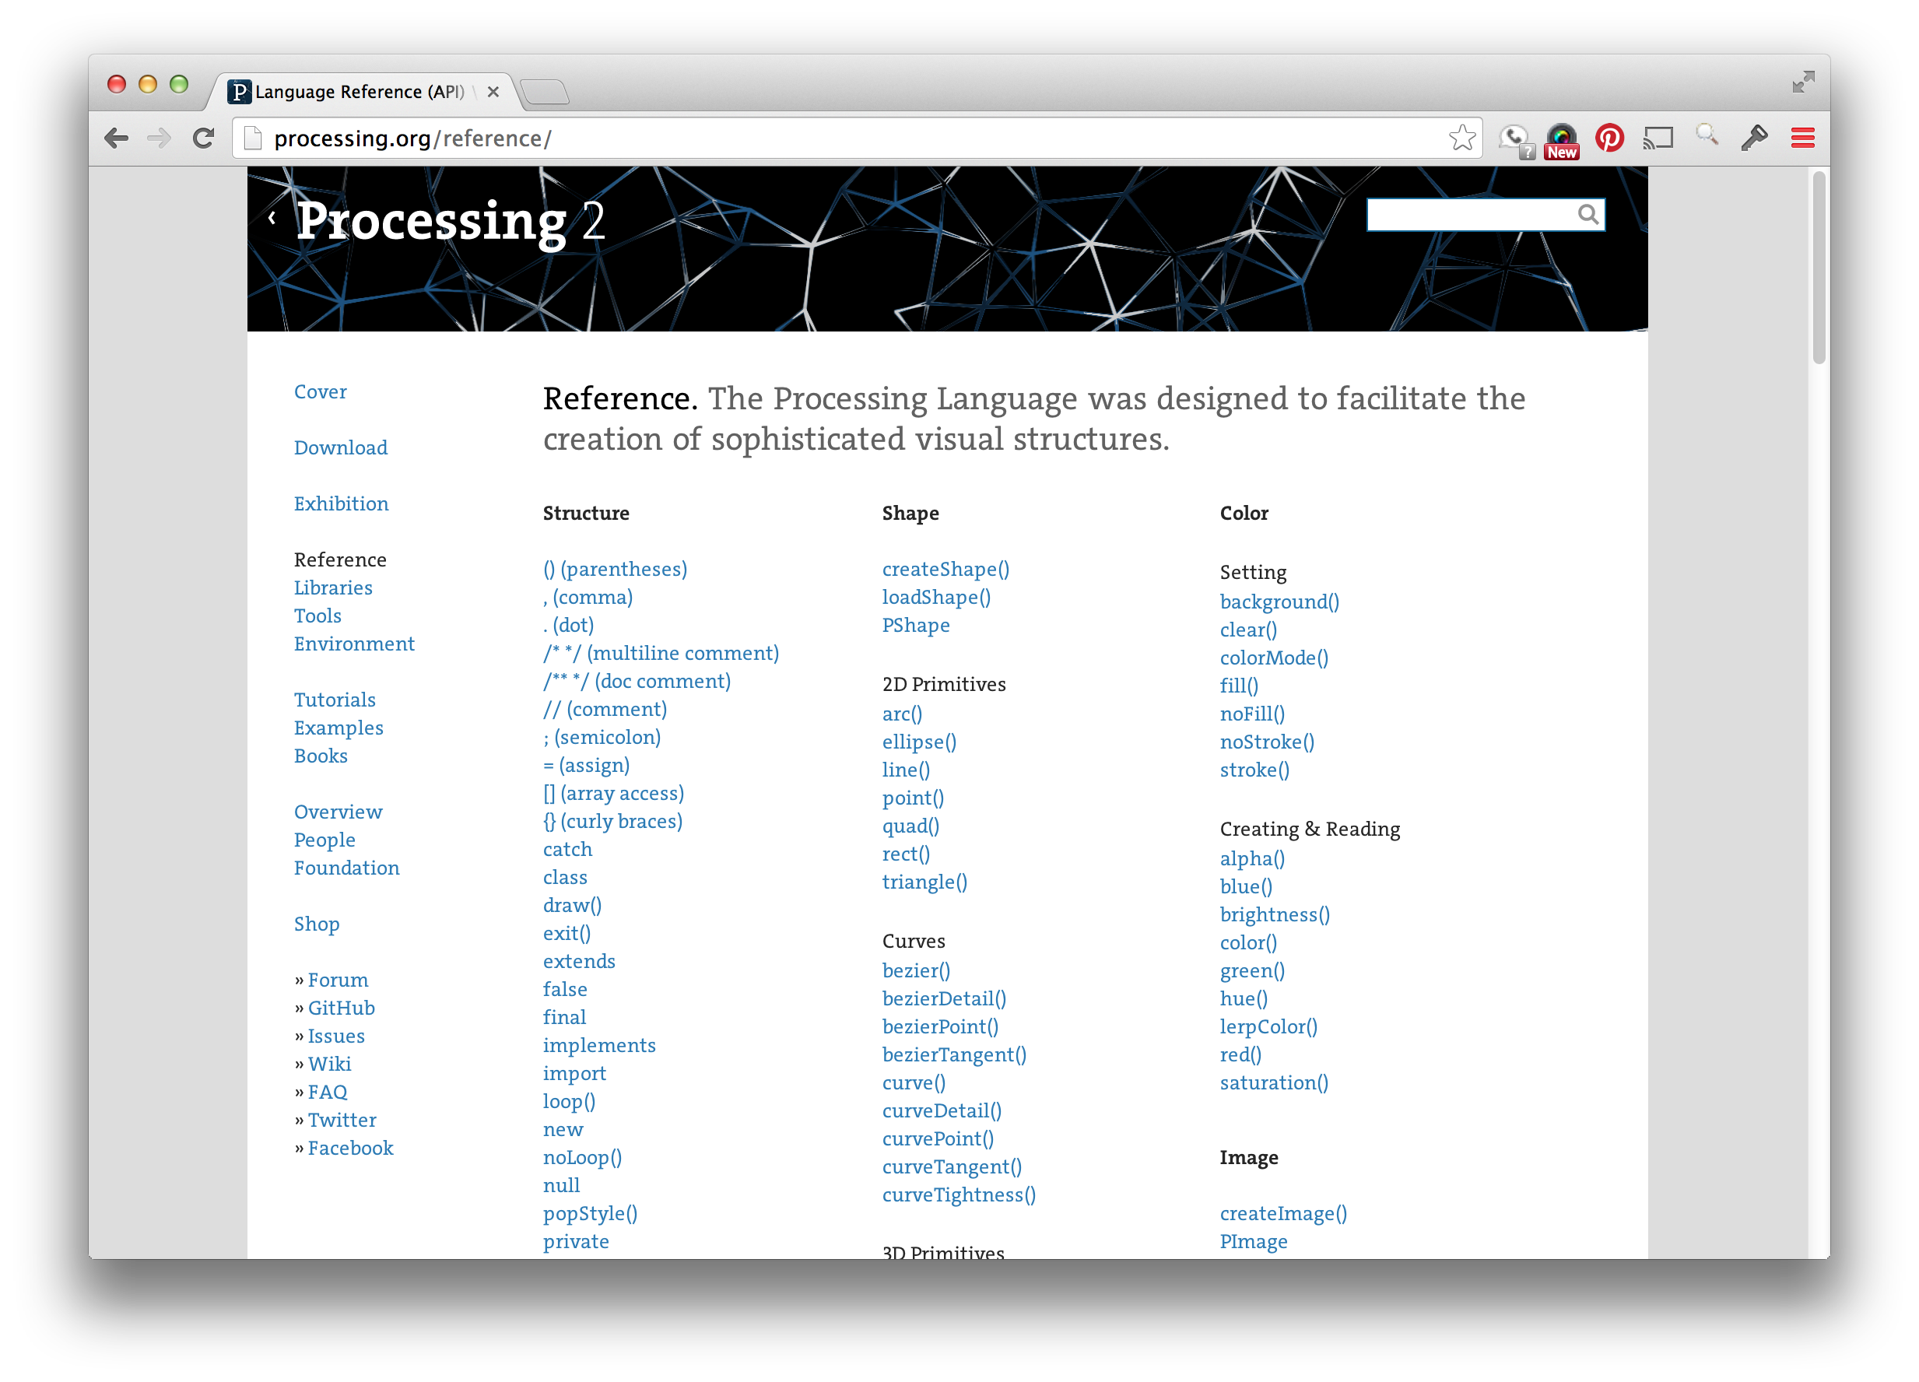
Notes:
So again one of the great things about using Processing is the large list of already created functions. If you want to draw a rectangle you just use the rect() function, if you want to draw a circle you use the ellipse() function and if you want to draw a more complex shape you use the vertex() function. But there are many more functions to choose from.

Slide 27
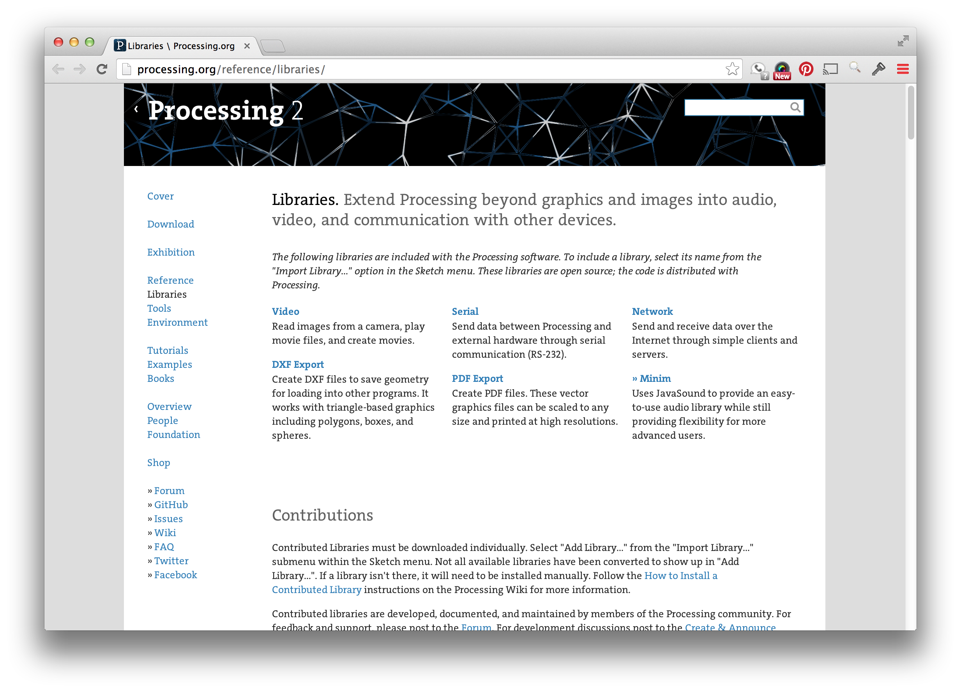
Notes:
On top of all the functions included with Processing there are a number of third party libraries that allow you to increase the number of functions you can reference. The PDF export library has functions for outputting vector PDFs from Processing, the Minim library allows you to work with audio input and output, the Geomerative library has functions for manipulating typography and box2d is a physics library that was actually used for Angry Birds.

Slide 28
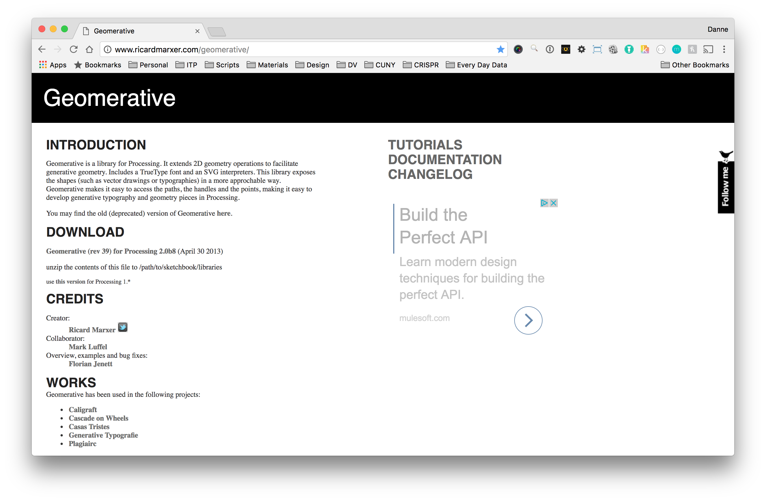

Slide 29
Danne Woo
creativecode.dannewoo.com
danne@dannewoo.com
@dannewoo

